Slide 1
Bike Sharing Demand Analytics
Sector: Transport
Student ID: 24613
Names: Ngwije Ngabo Gerard

Slide 2
Project Introduction
Sector: Transportation
Project Title: Bike Sharing Demand Analysis
Background : Urban bike sharing systems are increasingly popular for sustainable transportation. Understanding demand patterns helps optimize operations and improve user satisfaction.
Problem Statement: "Can we predict bike sharing demand patterns and identify key factors influencing urban mobility usage to optimize bike-sharing operations and improve urban transportation efficiency?"

Slide 3
Methodology
Data Preprocessing
Checked for and handled missing values (none found in this dataset)
Converted date columns to datetime format
Encoded categorical variables (season, weather, holiday, workingday)
Scaled numerical features (temperature, humidity, windspeed)
Detected and treated outliers in demand

Slide 4
Methodology
Exploratory Data Analysis (EDA)
Descriptive statistics for all features
Visualized:
Distribution of daily rentals
Rentals by season, weather, and working day
Correlation heatmap of all variables
Time series trends (monthly, weekly)

Slide 5
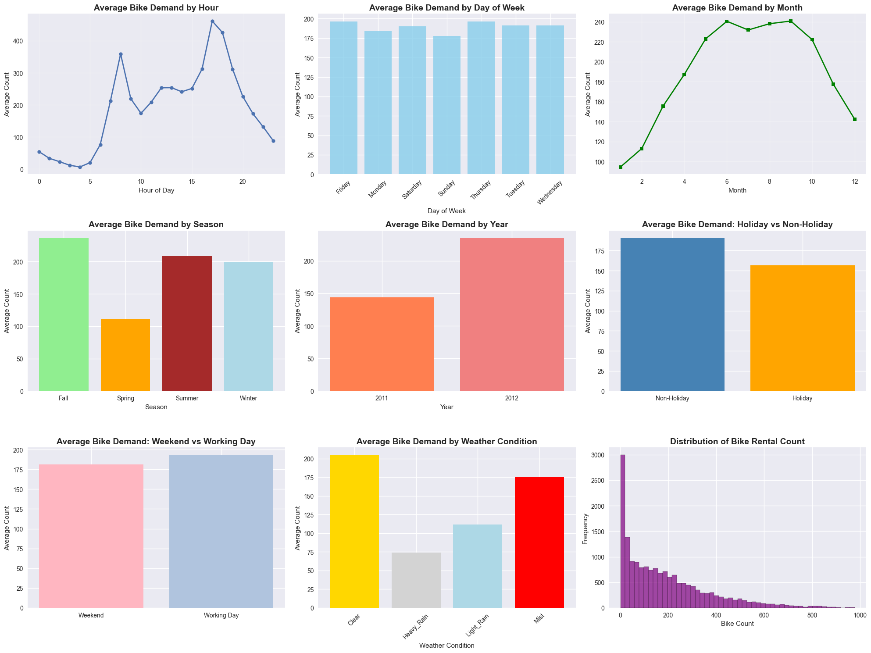
Results

Slide 6
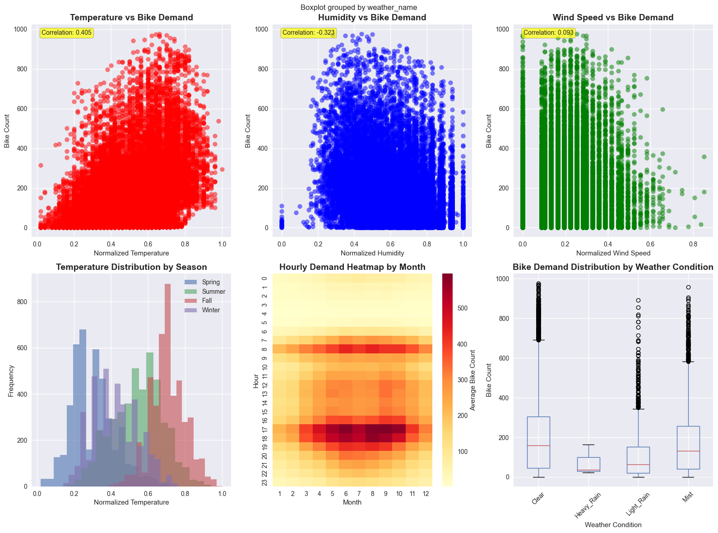
Results

Slide 7
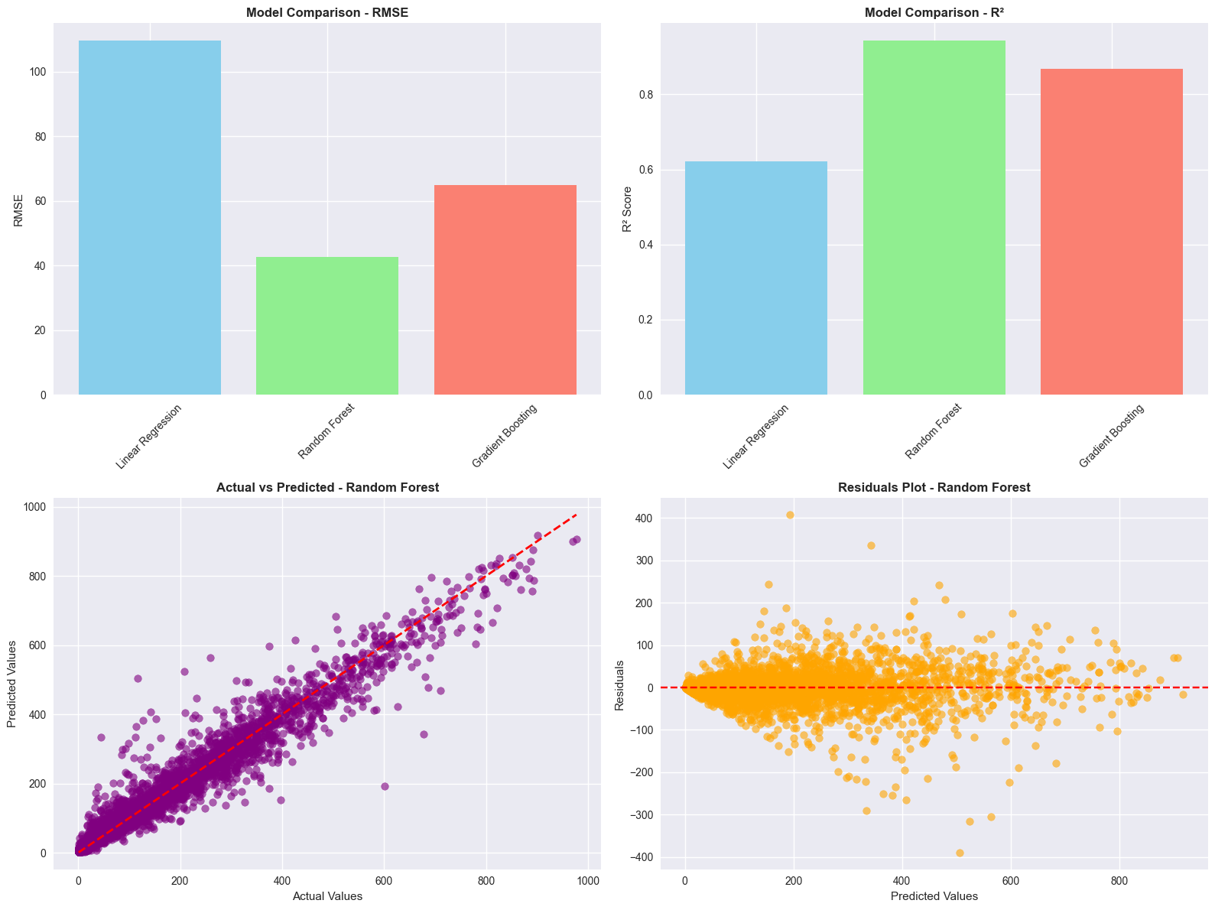
Results

Slide 8
Methodology
Modeling
Model Chosen: Linear Regression (for demand prediction)
Features Used: Season, weather, temperature, humidity, windspeed, holiday, workingday, etc.
Training/Test Split: 80/20
Model Training: Used scikit-learn for regression modeling

Slide 9
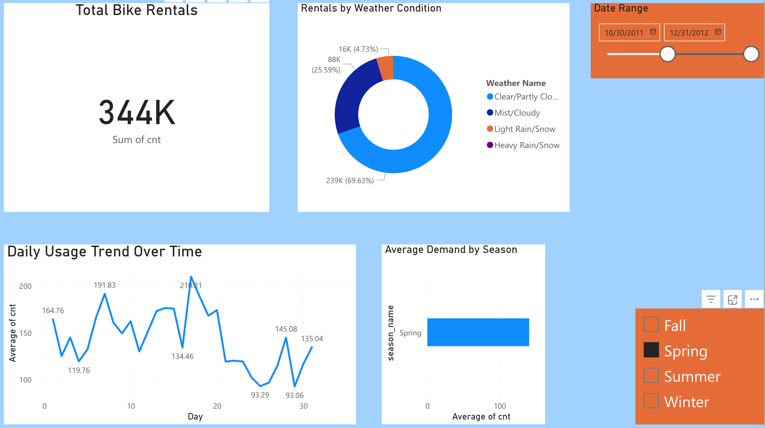
Power BI
Executive Summary

Slide 10
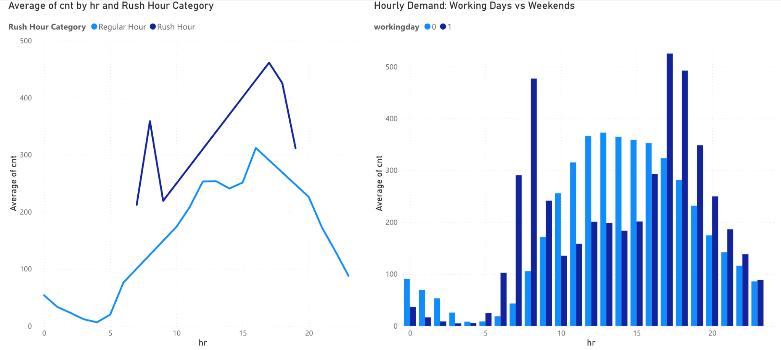
Power BI
Temporal

Slide 11
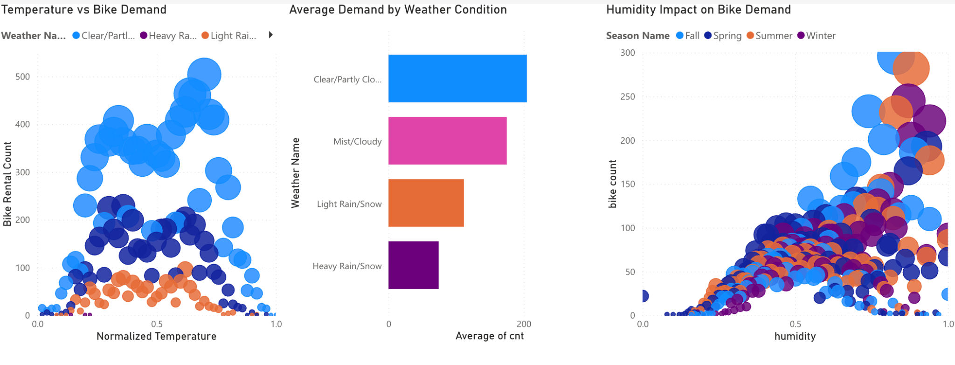
Power BI
Weather Impact

Slide 12
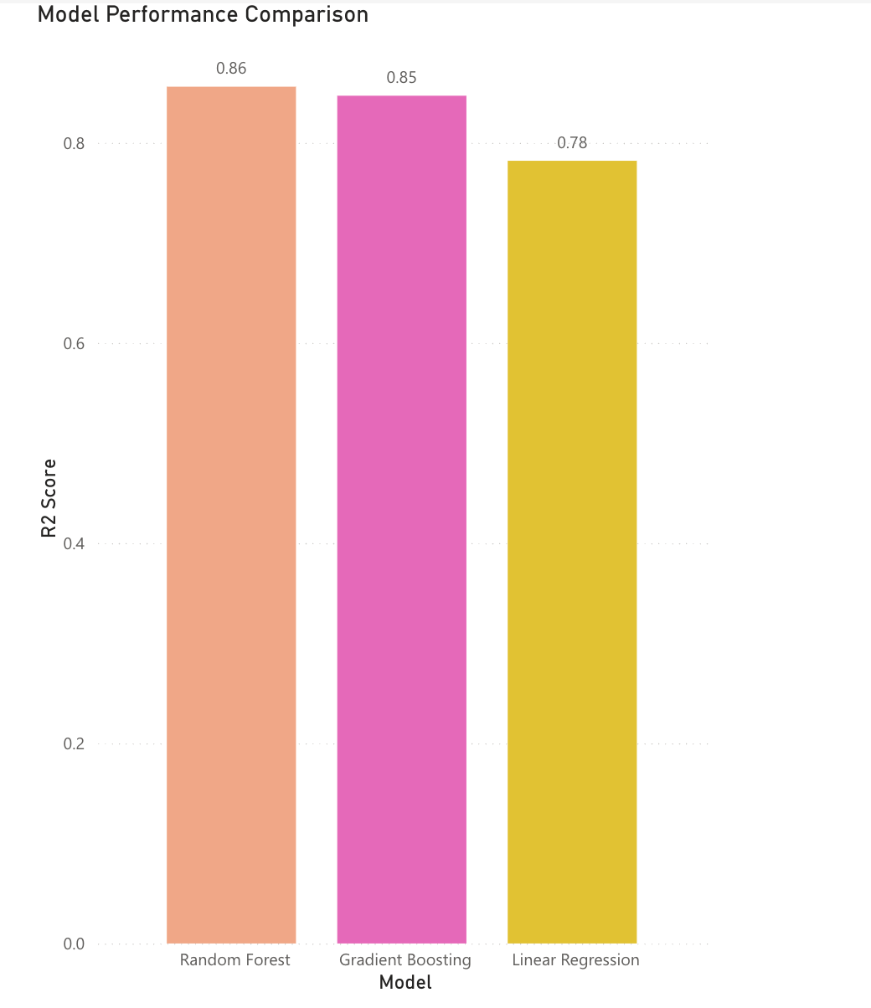
Power BI
Model Performance Comparison

Slide 13
Recommendations
Optimize bike availability during peak weather and seasonal periods.
Deploy 60% more bikes during rush hours (7-9 AM, 5-7 PM)
Reduce overnight fleet by 40% (10 PM - 6 AM)
Implement weather alert system for demand forecasting

Slide 14
Future Work
Integrate real-time weather and event data for dynamic prediction.
Explore advanced models (Random Forest, XGBoost, Time Series/ARIMA).
Expand to multi-city or multi-year datasets.
Incorporate user feedback and IoT sensor data for richer analysis.

Slide 15
Thank you.

